Slide 1
BrandNue
A project on branding and marketing
By: Rachel McGuire

Slide 2
What’s with the name?
Brand: a set of perceptions and images that represent a company, product or service.
Nue: Trendy and unique, standing out from the norm

Slide 3
EQ:
What is the importance of branding and why is marketing such an essential tool in today’s business world?

Slide 4
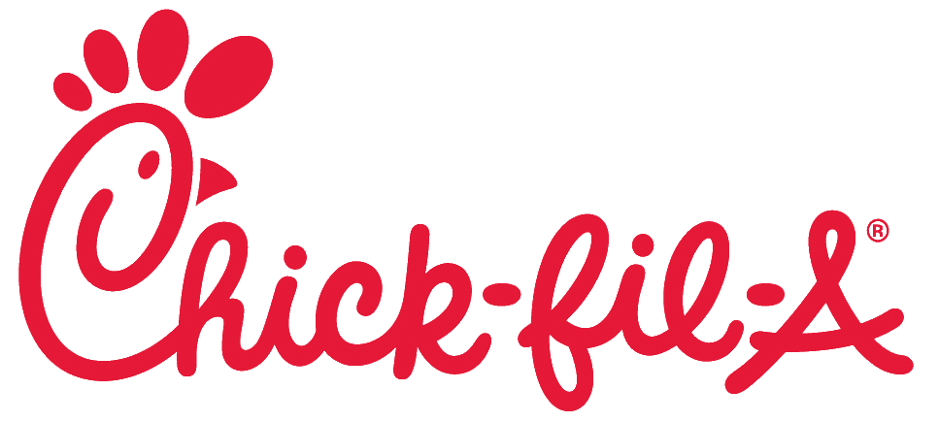
What is branding?
A distinguishing symbol, mark, logo, name, word, sentence or a combination of these items that companies use to distinguish their product from others in the market.
Often overlooked and created in a hurry, a company's brand is what they are conveying to their consumers. A brand is the company’s identify and therefore should be well thought out and deliberate.
Ex: Ritz Carlton, Apple, Starbucks, Chick-Fil-A

Slide 5
What is marketing?
The activities that are involved in making people aware of a company's products, making sure that the products are available to be bought, etc. Such activities are normally called advertising
Further research proved that internet and social media marketing generated more advances and inquiries, which in turn lead to higher sales in a company.
Marketing is, like Tammy Brown of Mighty 8th Media said, “an essential tool if you want your business to grow. Marketing can take a business from concept to market, then support or improve it. If not, [a company’s] brand could potentially get deluded.”
92% of marketers in 2014 claimed that social media marketing was important for their business, with 80% indicating their efforts increased traffic to their websites.

Slide 6
T.V.

Slide 7
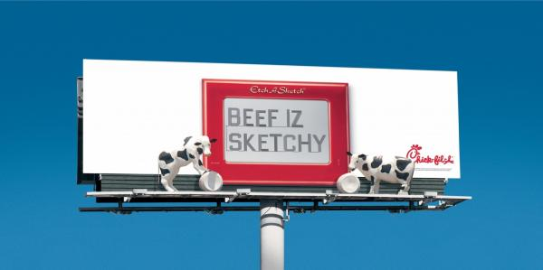
Print

Slide 9
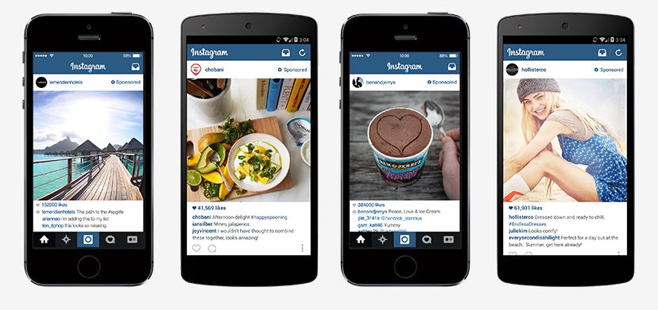
Internet/Social Media

Slide 10
What’s the Point of Branding?
Often overlooked and created in a hurry, a company's brand is what they are conveying to their consumers. A brand is the company’s identify and therefore should be well thought out and deliberate.
This is the basis of your company, or the foundation. It portrays to your audience what your company is, what makes it different, and the effect is something that could help or hurt a business drastically
One of the most important things to remember when branding is to make sure it conveys all you want your audience to perceive, while keeping the design eye catching, yet simple.
“All elements in a good brand are consistent, even down to the packaging. Wherever you go. you always know what you’re going to get. It’s clean.”
-Tammy Brown, Senior Designer at Mighty 8th Media

Slide 11
Why bother with Marketing?
Further research proved that internet and social media marketing generated more advances and inquiries, which in turn lead to higher sales in a company.
Marketing is, like Tammy Brown of Mighty 8th Media said, “an essential tool if you want your business to grow. Marketing can take a business from concept to market, then support or improve it. If not, [a company’s] brand could potentially get deluded.”
92% of marketers in 2014 claimed that social media marketing was important for their business, with 80% indicating their efforts increased traffic to their websites.
With competition at it’s highest in American history, good marketing could be the key to put your business a step in front of the competitions.

Slide 12
Forbes Magazine writes that if nothing else, good marketing…
1. Increases brand recognition
2. Improves brand loyalty
3. More opportunities to convert
4. Higher conversion rates

